Slide 1

Assessing the Role of Technological Progress in Shaping Birth Rate Trends in the United States
Chizoma Oparaji, Laleh Saadatmand, Samuel Akinboyo, Vinay Kumar
EPPS 6302.001 Fall 2024
Instructor: Dr. Karl Ho

Slide 2
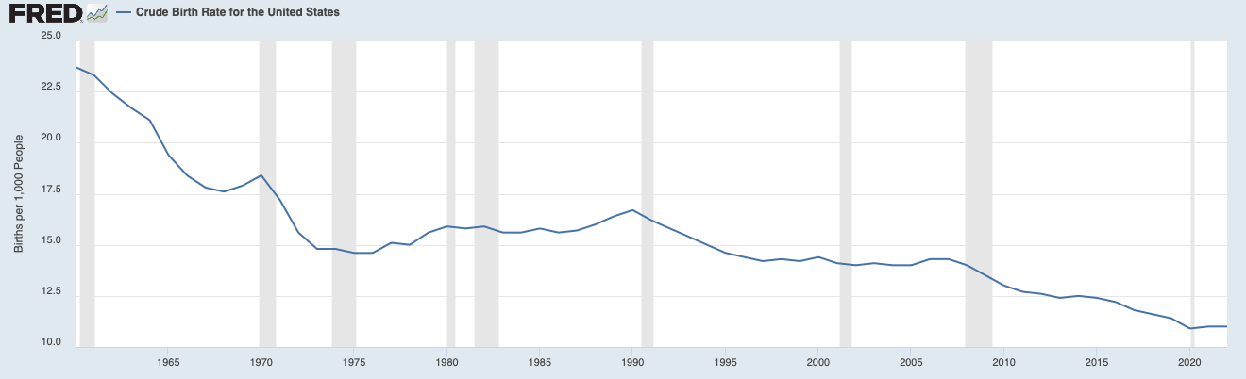
Introduction
The fall and rise of birth rates in the United States is a complex issue influenced by numerous social, demographic, economic, and policy-related factors. According to the National Center of Health Statistics, the number of births in the United States declined 2% from 2022 to 2023 (National Health Statistics, 2023). Birth rates are critical indicators of population growth, and fluctuations in these rates can have profound consequences for society. Declining birth rates may contribute to an aging population, creating economic pressures as fewer working-age adults support a larger elderly population, while rising birth rates may put pressure on public resources, such as education and healthcare, for younger generations (Kearney, Levine & Pardue, 2022).

Slide 3

Research Statement and Hypothesis
Our study aims to underscore the impact of technological advancements in shaping birth rate trends in the United States. As technology continues to transform various aspects of life, including healthcare, fertility treatments, and family planning, hence, it is expedient to explore how these technological advancements have shaped reproductive behavior and the rise and fall in birth rate patterns. Our study will analyze the impact of medical technology innovations such as IVF, embryo banking, contraceptives usage, and economic factors tied to technological growth on the birth rate trends in the U.S. over recent times.
Null Hypothesis: Hypothesis: Technological advancements in fertility treatments are negatively associated with higher birth rates in the United States.
Alternate Hypothesis: Technological advancements in fertility treatments are positively associated with higher birth rates in the United States.

Slide 4



Methods
The effect of advances in the field of medicine on women across several parts of the globe has been focal. Over the years, the evolution of the proportion of women using contraceptives has increased. Data from sources such as Statista will be used to learn about the sales of contraceptives in the United States.
Information about fertility treatments in the United States will also be collected from the Centers for Disease Control and Prevention (CDC), this information will significantly help in analyzing relationships between such variables. Demographic data in terms of the population in the United States, especially according to the US Census Bureau will also be collected.
To this end, web scraping from different websites under this topic will be done with R programming. Statistical analysis will be conducted using R Programming. Even though most of the data will be readily available we will be examining the effect of medical technology advancement on the birth rate.
Indicators- race, age, household income, number of abortions, contraceptive sales, IVF/ embryo banking

Slide 5

Conclusion
While there has been research related to our topic before, most studies have had a focus on the decline of birth rates due to social lifestyles and economic factors. Our research aims to further analyze technological advancements as an additional factor that may provide insights into issues revolving around birth rates.

Slide 6
References
Centers for Disease Control and Prevention. (2024, August 20). Products - data briefs - number 507 - August 2024. Centers for Disease Control and Prevention. https://www.cdc.gov/nchs/products/databriefs/db507.htm#section_1
Centers for Disease Control and Prevention. (n.d.). Abortion surveillance findings and reports. U.S. Department of Health and Human Services. https://www.cdc.gov/reproductive-health/data-statistics/abortion-surveillance-findings-reports.html
Kearney, M. S., Levine, P. B., & Pardue, L. (n.d.). The puzzle of falling us birth rates since the Great Recession. Journal of Economic Perspectives. https://www.aeaweb.org/articles?id=10.1257%2Fjep.36.1.151
Santelli, J. S., Lindberg, L. D., Finer, L. B., & Singh, S. (2007). Explaining recent declines in adolescent pregnancy in the United States: the contribution of abstinence and improved contraceptive use. American journal of public health, 97(1), 150-156. https://ajph.aphapublications.org/doi/pdf/10.2105/AJPH.2006.089169
Swan, L. E. (2021). The impact of US policy on contraceptive access: a policy analysis. Reproductive Health, 18, 1-14. https://link.springer.com/content/pdf/10.1186/s12978-021-01289-3.pdf
Wang, J., & Sauer, M. V. (2006). In vitro fertilization (IVF): a review of 3 decades of clinical innovation and technological advancement. Therapeutics and clinical risk management, 2(4), 355-364. https://www.tandfonline.com/doi/pdf/10.2147/tcrm.s24355

Slide 7

Thank You
Questions?

